Slide 1


Oracle Application Testing Suit Project
Kick-Off
July 15th 2019

Slide 2
Agenda
Introduction
Project Scope
Execution Approach
High Level Plan & Current Status
Next Action & Support Required
Q&A

Slide 3
Introduction:
Subhasis Jana - Project Manager
Sujit Swain– Oracle application testing suite consultant
Functional Leads (IBM)
Business Process Owners (Ma’aden)

Slide 4
Project Scope:
At present no tools available in the project to automate testing of functional/technical changes for Oracle EBS.
Implementation Scope:
Setup Oracle application testing suite to fulfil the test requirements of Oracle EBS through Oracle Test Manager functionality.
Target to automate 20 Test Cases for this project.
Perform test automation by automating repeatable, reusable tests cases using tools and enabling execution.
Benefit:
OATS will help to reduce testing time and efforts and increase efficiency and productivity in testing cycle.
OATS will help to plan, organize, document, and manage the entire application testing process
Track defects and manage test requirements
Web-based test management solution

Slide 5
Oracle Test Manager Flow:
Integrated test modules provide complete test process management.
Test Plan, Test Requirements, Test Cases, Test Execution and Issues (Defects), Dashboard.
Document Test Requirement
Test Plan
Write Test Cases
Execute Test Cases
File Defects Found By Test execution
View Reports & Dashboard

Slide 6
Execution Approach:
Inception (Planning):
Kick-Off
On-board Project team
Finalize pre-requisite infrastructure for OATS, EBS application and Licenses
Detailing Project Plan & Tracker
Elaboration & Construction (Design & Build):
Installation and configuration of OATS
Develop functional, system test plans and schedules
Setup Oracle Applications Test Manager for Test Case Management
Record and report test results to Ma'aden & Complete test documentation
Verify compliance with Ma'aden's testing specifications and requirements
Develop Automated Test script as part of the Testing using OATS Tool.
Unit testing
Transition (Testing):
Prepare up to 20 scripts
Conduct UAT and Sign-Off
Sign Off Criteria:
IBM to submit Implementation Completion report to Ma'aden. OATS Implementation Completion report deliverable consists of:
Test Automation Process
Implementation Completion Report

Slide 7
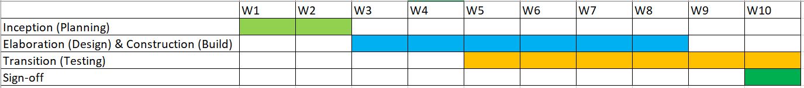
High Level Project Plan:
Overall Project Plan is 10 weeks out of which 2 weeks are for Planning, 4 weeks for Design & Build and 4 weeks for Testing.
Implementation Completion report to be submitted
Weekly updates to be published in weekly review.
Progress so-far:
Kick Off -
Obtain Server & OATS license -
Onboard IBM Project team to proceed with Inception phase –
Infrastructures readiness for OATS system Installation –
Identify Business Stakeholders –

Slide 8
Next Action (Commence Inception Phase):
Kick Off
On boarded Project team
Finalize pre-requisite infrastructure for OATS and EBS and License
Detailing Project Plan & Tracker
Support Required:
Finalize Infrastructure & License

Slide 9
Backup slides

Slide 10
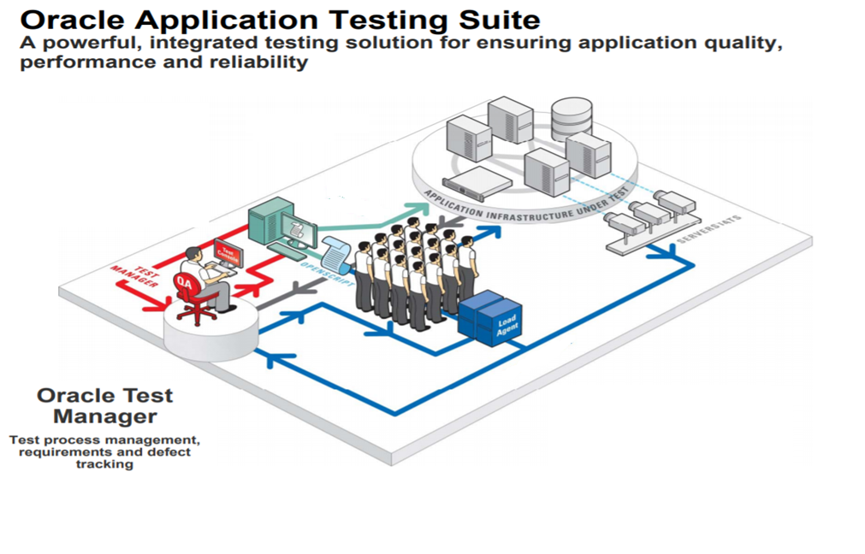

Slide 11
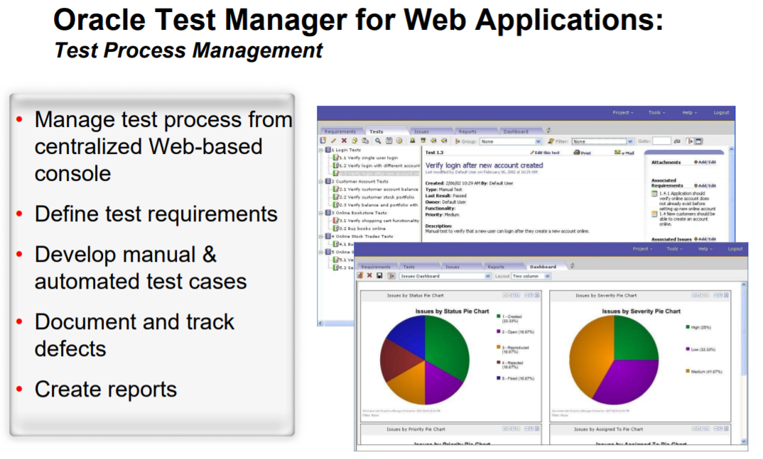

Slide 12
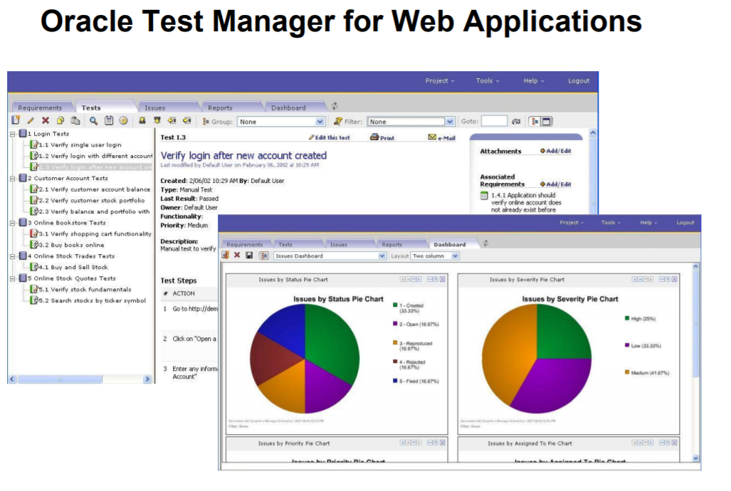

Slide 13
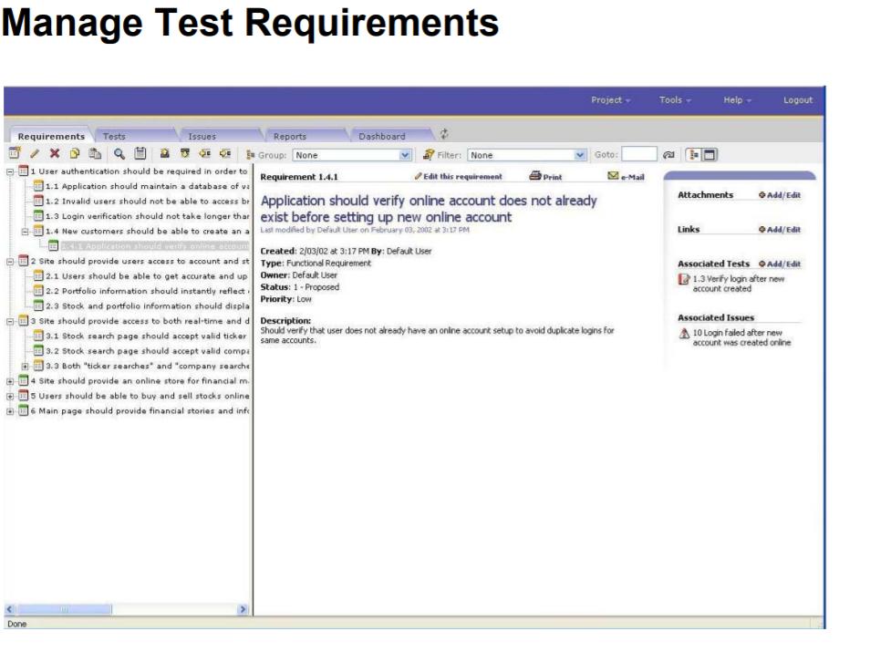

Slide 14
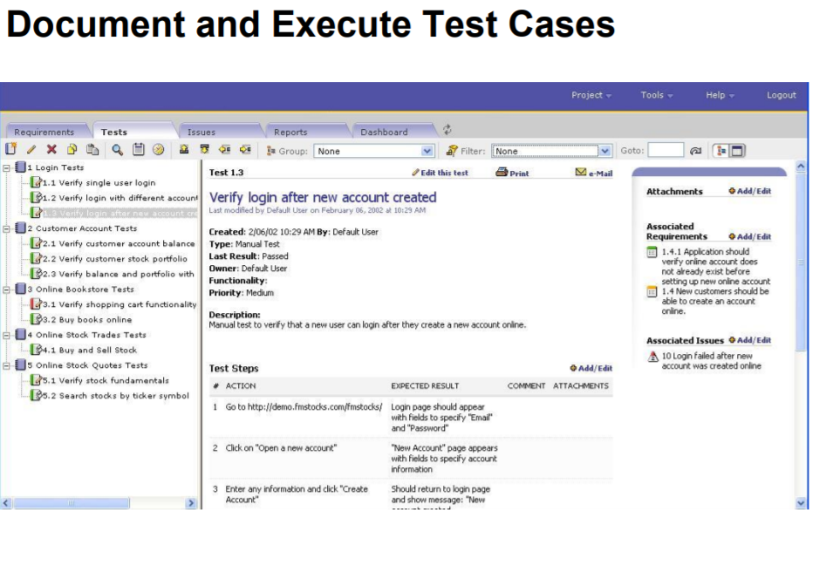

Slide 15
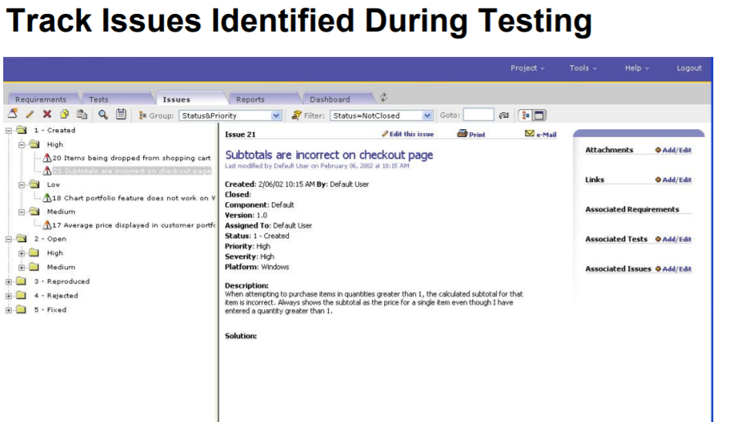

Slide 16
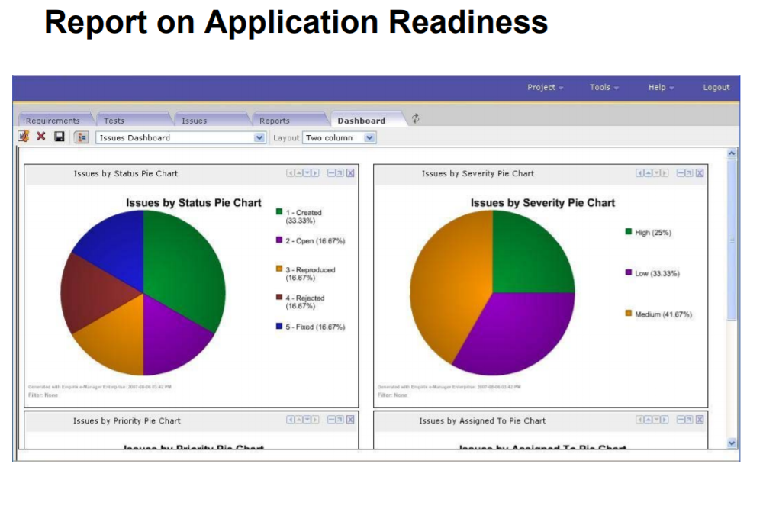

Slide 17


